Slide 1

How has COVID-19 Affected the Stock Market?
Group C:
Yankang Zhu
Joe Tait
Paul-Andrei Codrea
Dariya Angelova

Slide 2
Aims:
To prove a bearish downturn
To prove a shift from equities to ‘safer’ asset classes
To highlight the winning/losing industries from COVID-19
To prove a relationship between market sentiment and market prices

Slide 3






Tools used:
Collaboration
Data Collection
Data Manipulation
Graph Generation

Slide 4
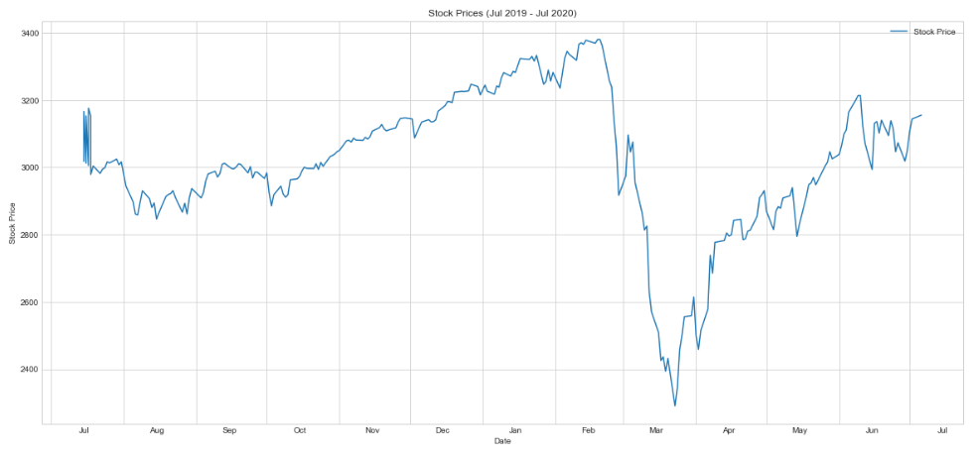
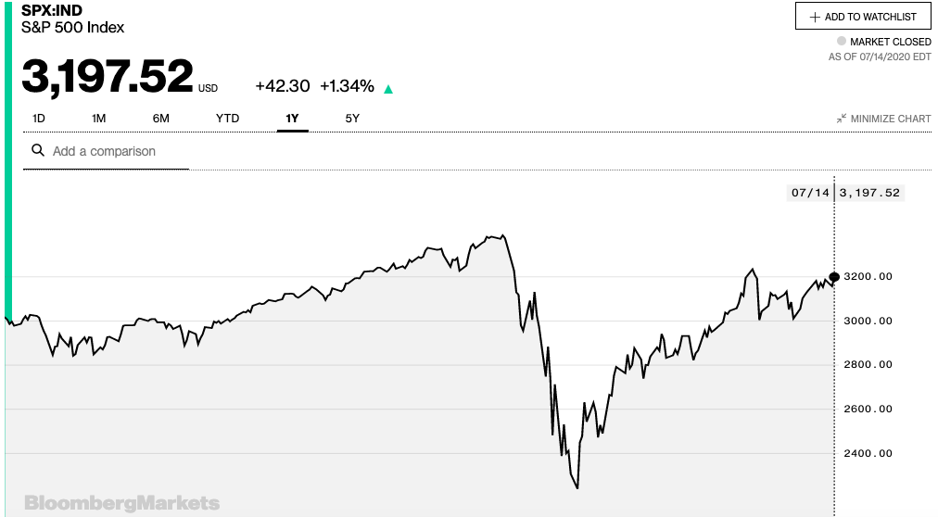
A bearish downturn…

Slide 5
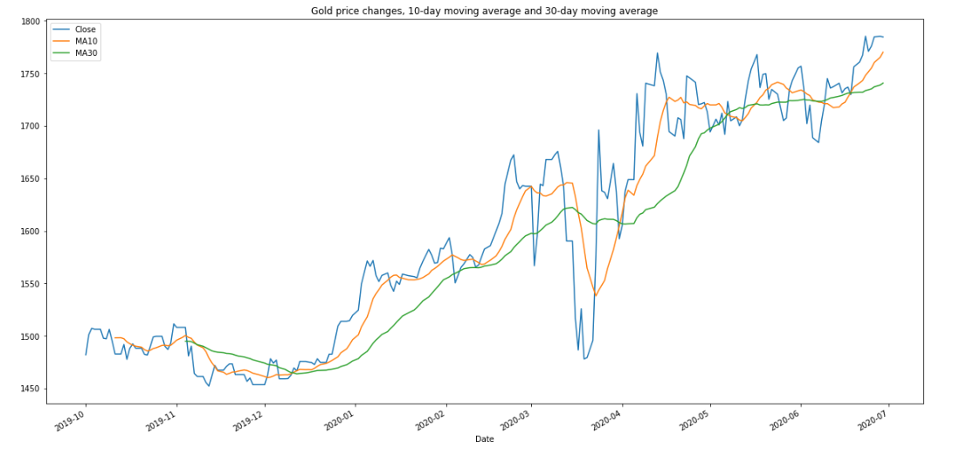
Investors flee for safe-havens…

Slide 6
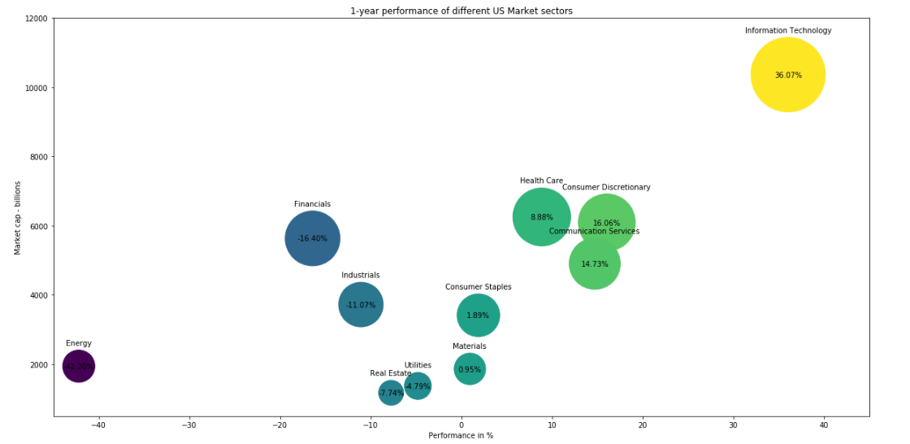
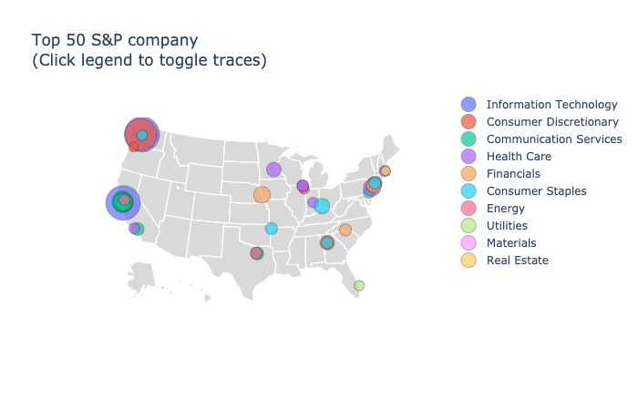
Winners and losers from COVID-19…

Slide 7
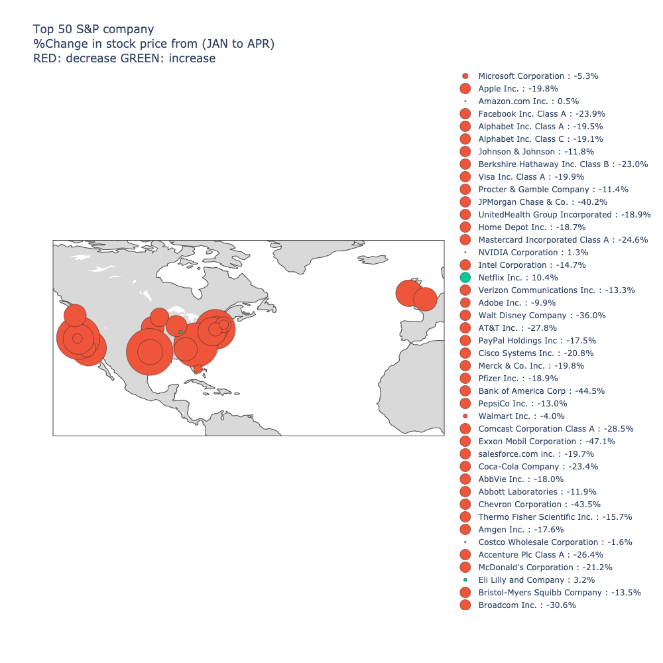

Slide 8
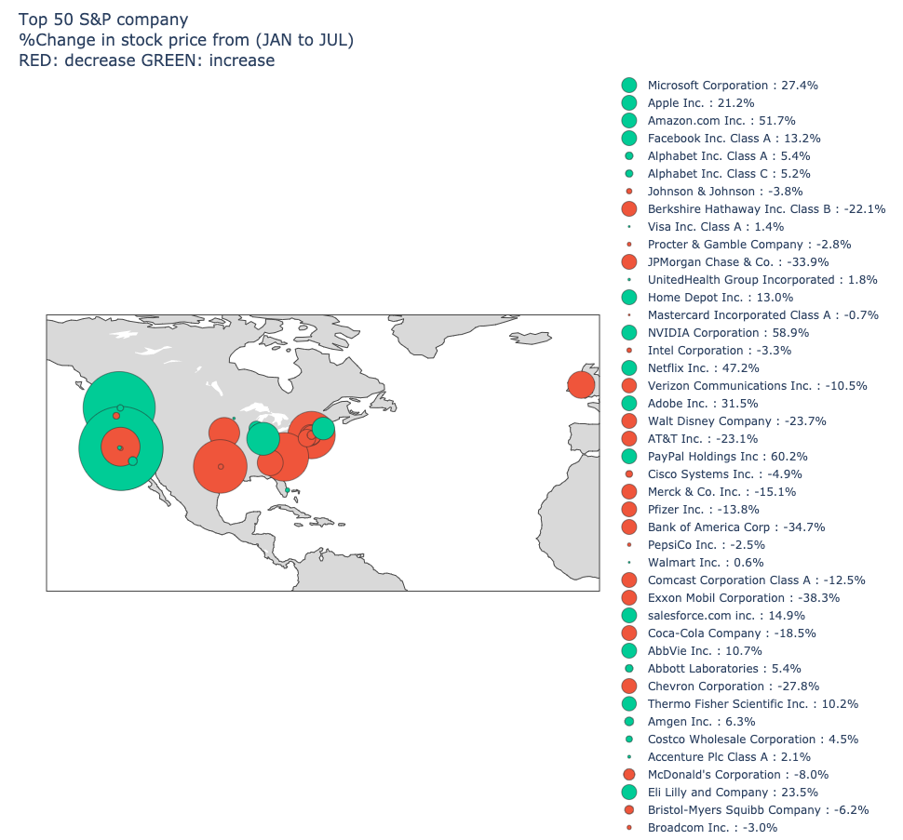

Slide 10
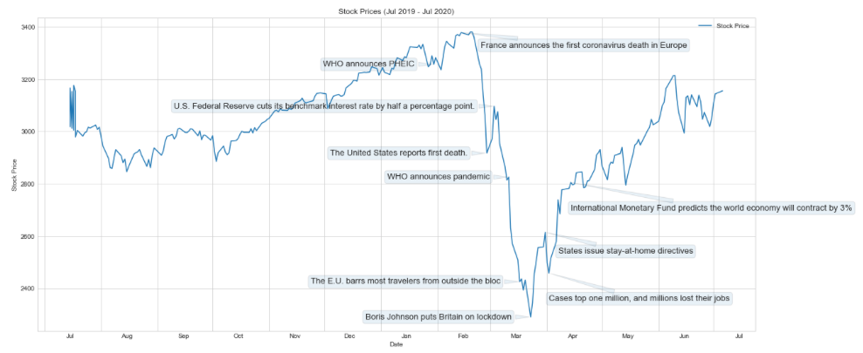
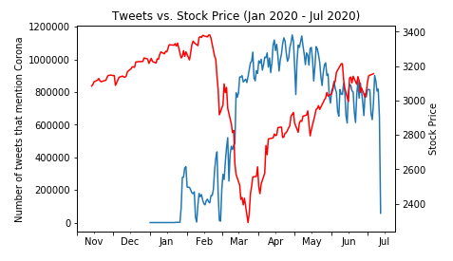
Market Sentiment Vs. Market Price…

